Slide 1
CM Géo éco UK
LEA1 semestre 2 2020-2021 – UniversitÉ jean moulin lyon 3
M. Bourdeau

Slide 2
Objectifs
Compréhension des dynamiques géo-économiques (lien espace géographique et développement éco)
=> focus sur histoire, géo (cartes), institutions (exécutif, législatif, judiciaire, médias), régions.
Point focal : enjeux éco et politiques et leur répartition spatiale.

Slide 3
Contents
1. General Introduction
2. London & institutions
3. North/South divide
4. Wales
5. Scotland
6. Northern Ireland

Slide 4
Exam
The exam will consist in a series of 30 multiple-choice questions at the end of the semester
“Terminal écrit”, 30 min

Slide 5
Ressources utiles
marion.bourdeau@univ-lyon3.fr
Moodle: BOURDEAU CM LEA1 Géoéco UK 2020-2021 s2

Slide 6
Bibliography:
Pickard, Sarah, Civilisation Britannique, Paris : Pocket, 2015. [ouvrage bilingue]
John, Peter. Lurbe , Pierre, Civilisation Britannique (8ème edition), Paris : Hachette, 2014
Mioche, Antoine, Les grandes dates de l’histoire britannique, Paris : Hachette, 2010
Webography :
British history : http://www.bbc.co.uk/history/british/
Encyclopedia Britannica: https://www.britannica.com/ (accès limité)
British institutions : https://www.gov.uk/government/how-government-works

Slide 7

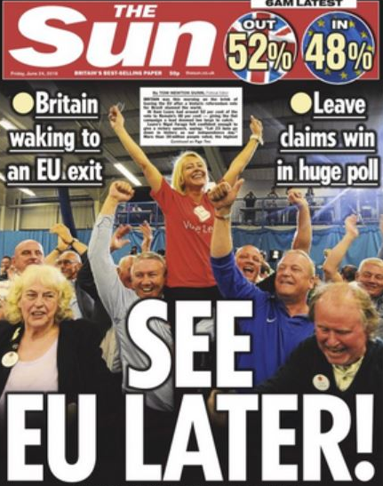
Brief Brexit reminder :
(2016: referendum: 52% OUT vs 48% IN
(2016-2020: deal-no deal? Out date postponed over and over again
Dec 24th 2020: UK/EU deal
Dec 31st 2020/Jan 1st 2021: UK out)
<= 2016, the UK =
https://www.franceculture.fr/emissions/series/grande-bretagne-keep-calm-and-carry?fbclid=IwAR3OKLW2J2ihQVR7ImEuBJro6G3wAFo0jsyR5VRlE_U2Dgb0VErUZwBcpmo
‘Keep Calm and Carry On’: 3 podcasts about Brexit

Slide 8
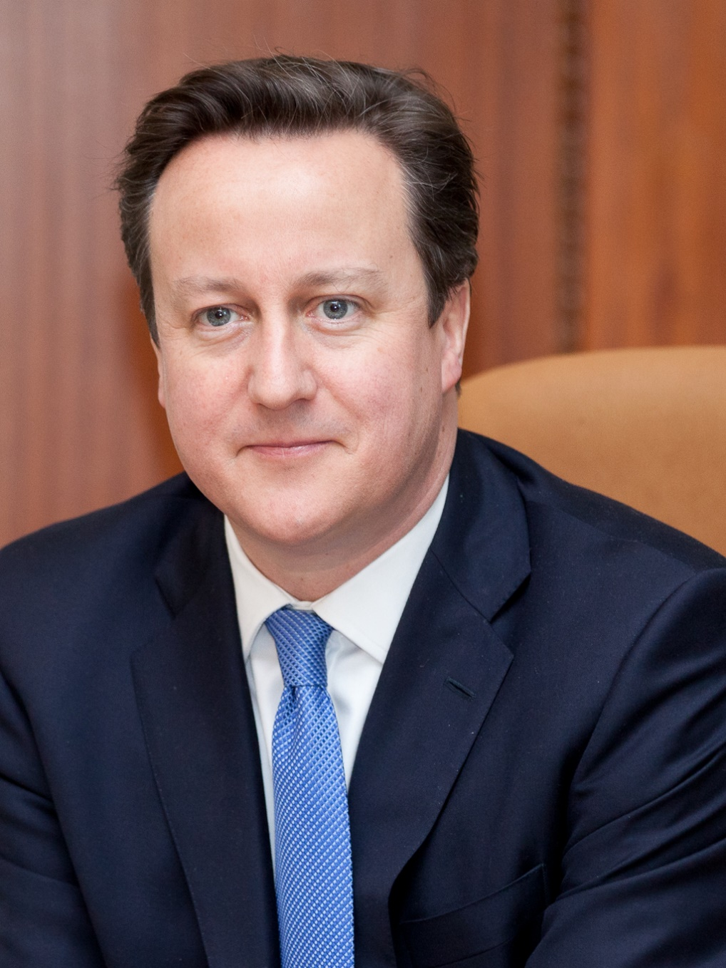
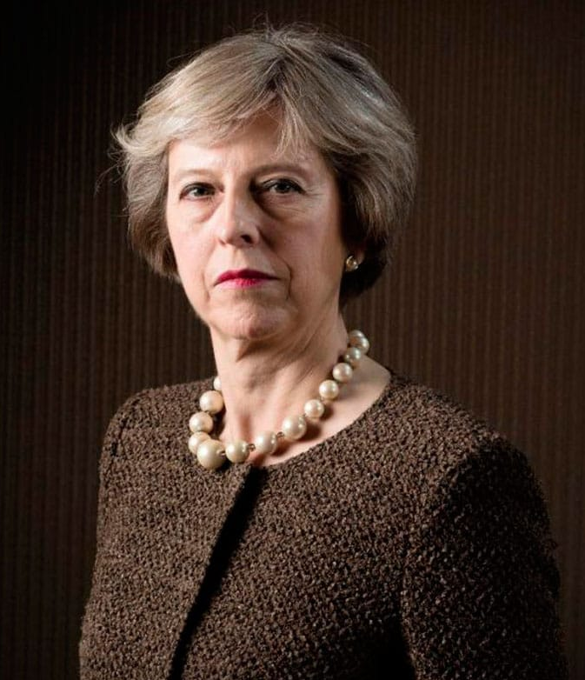
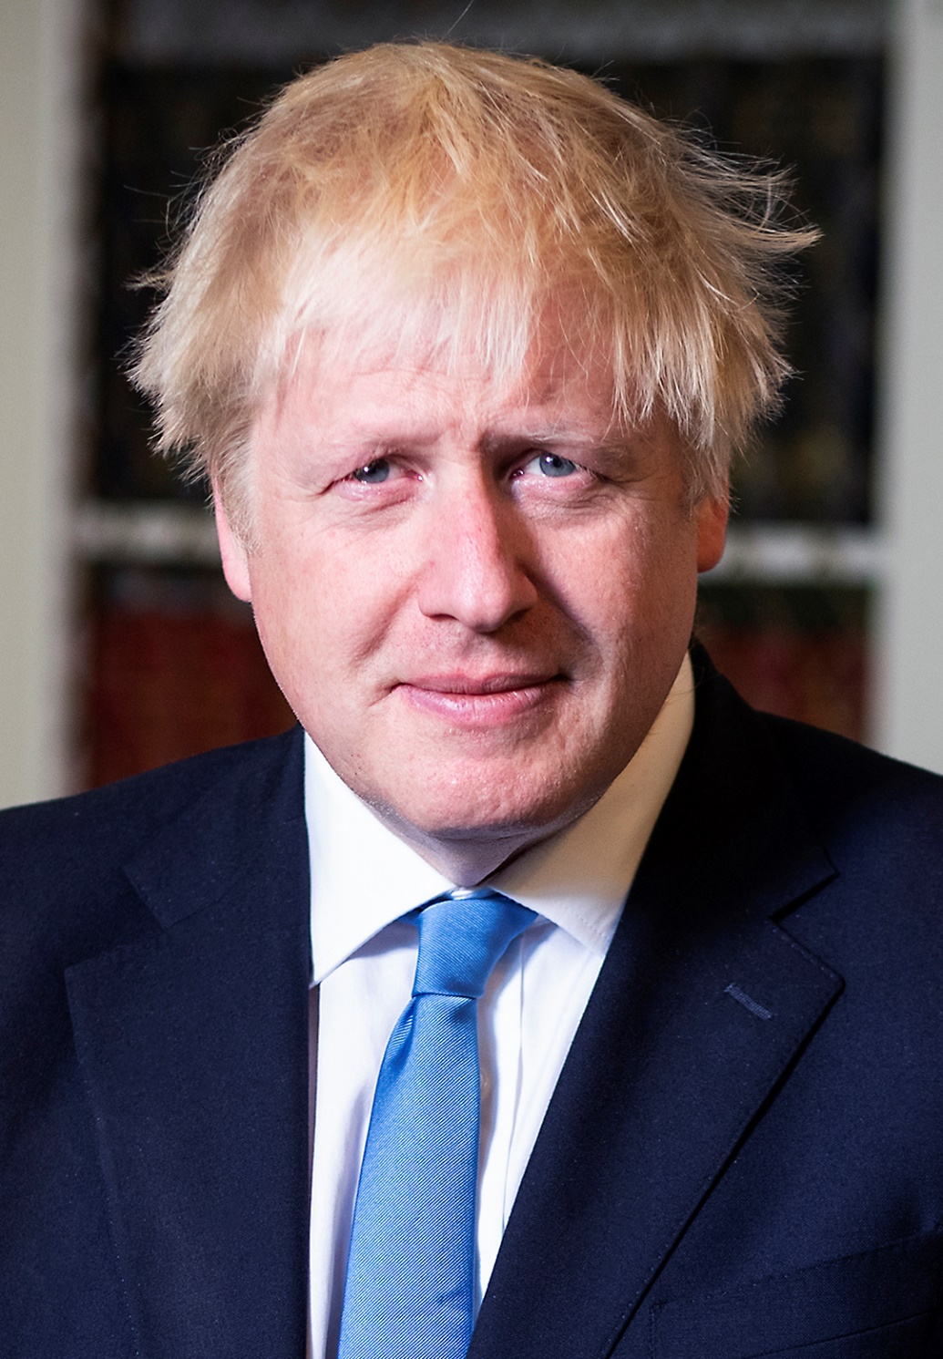

Slide 9

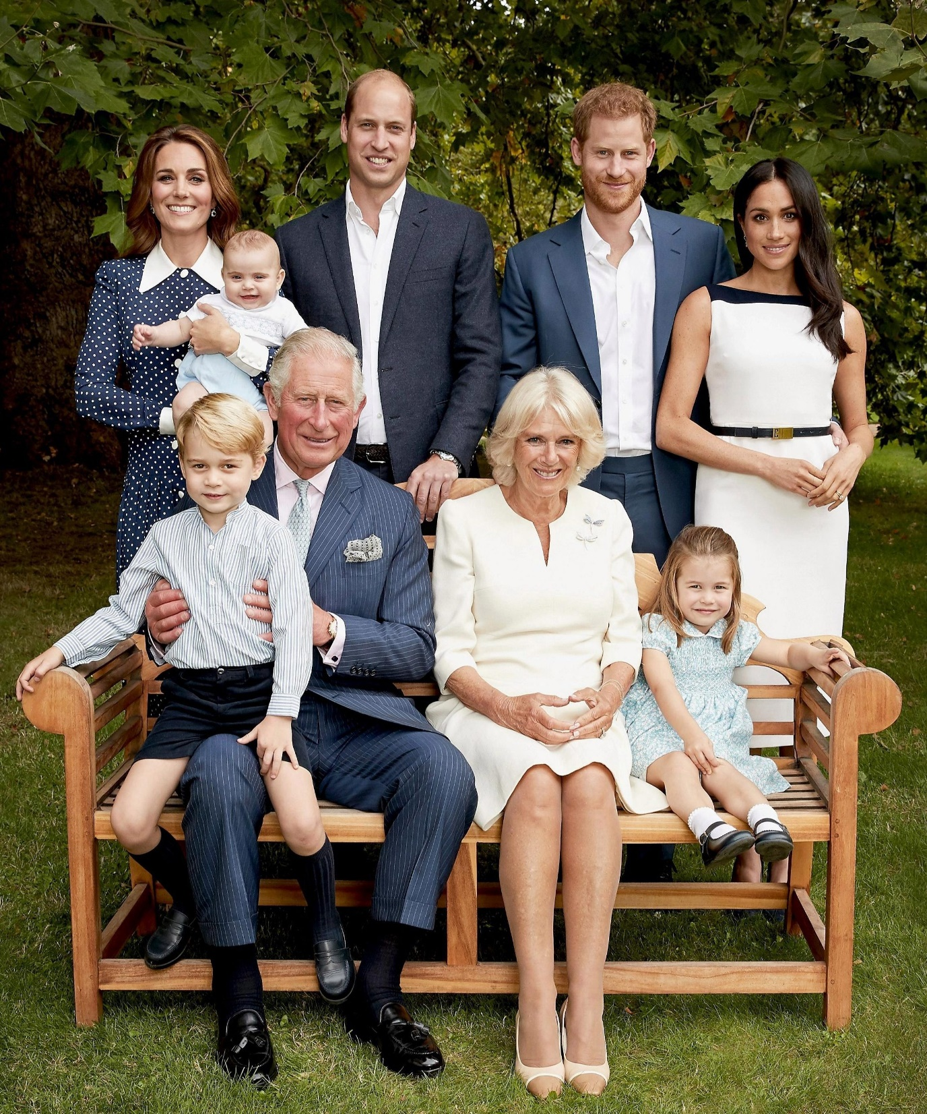

Slide 10
Besides Brexit, what first comes to your mind when you think about
The UK?
Scotland?
Wales?
Ireland?

Slide 11
Part 1: General Introduction

Slide 12
Contents
1. Basic Geographical and Historical Data
2. Some Constitutional Remarks
3. Population and linguistics

Slide 13
1. BASIC GEOGRAPHICAL AND HISTORICAL DATA

Slide 14
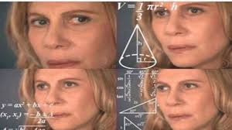
England?
Great Britain?
The United Kingdom?
The British Isles?

Slide 15
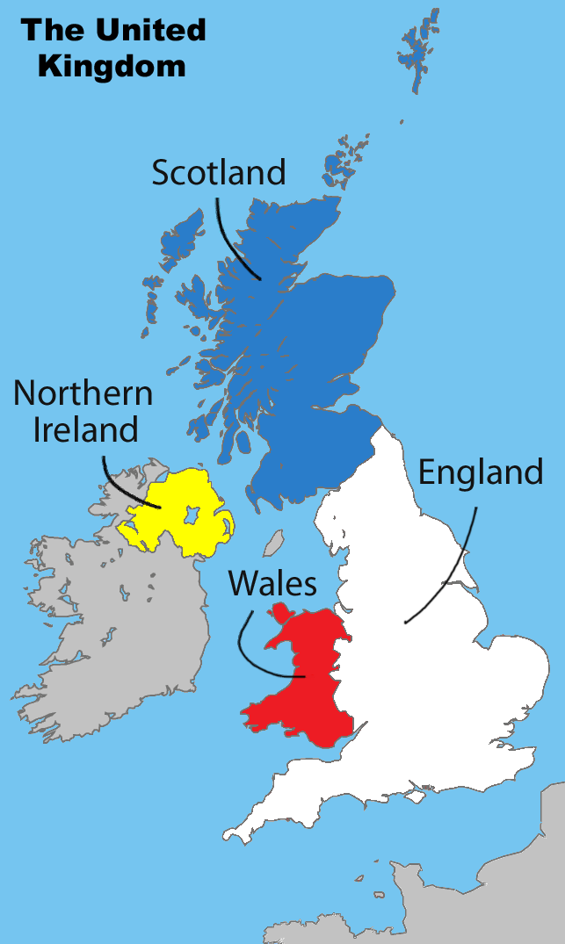

A) The United Kingdom of Great Britain and Northern Ireland, or the U.K. for short. (1927)
1927 <- coined to recognize in name the Independence of the Irish Free State (1922).
The inhabitants of the UK = Britons ($≠$Breton, from Brittany in France).
British by nationality

Slide 16
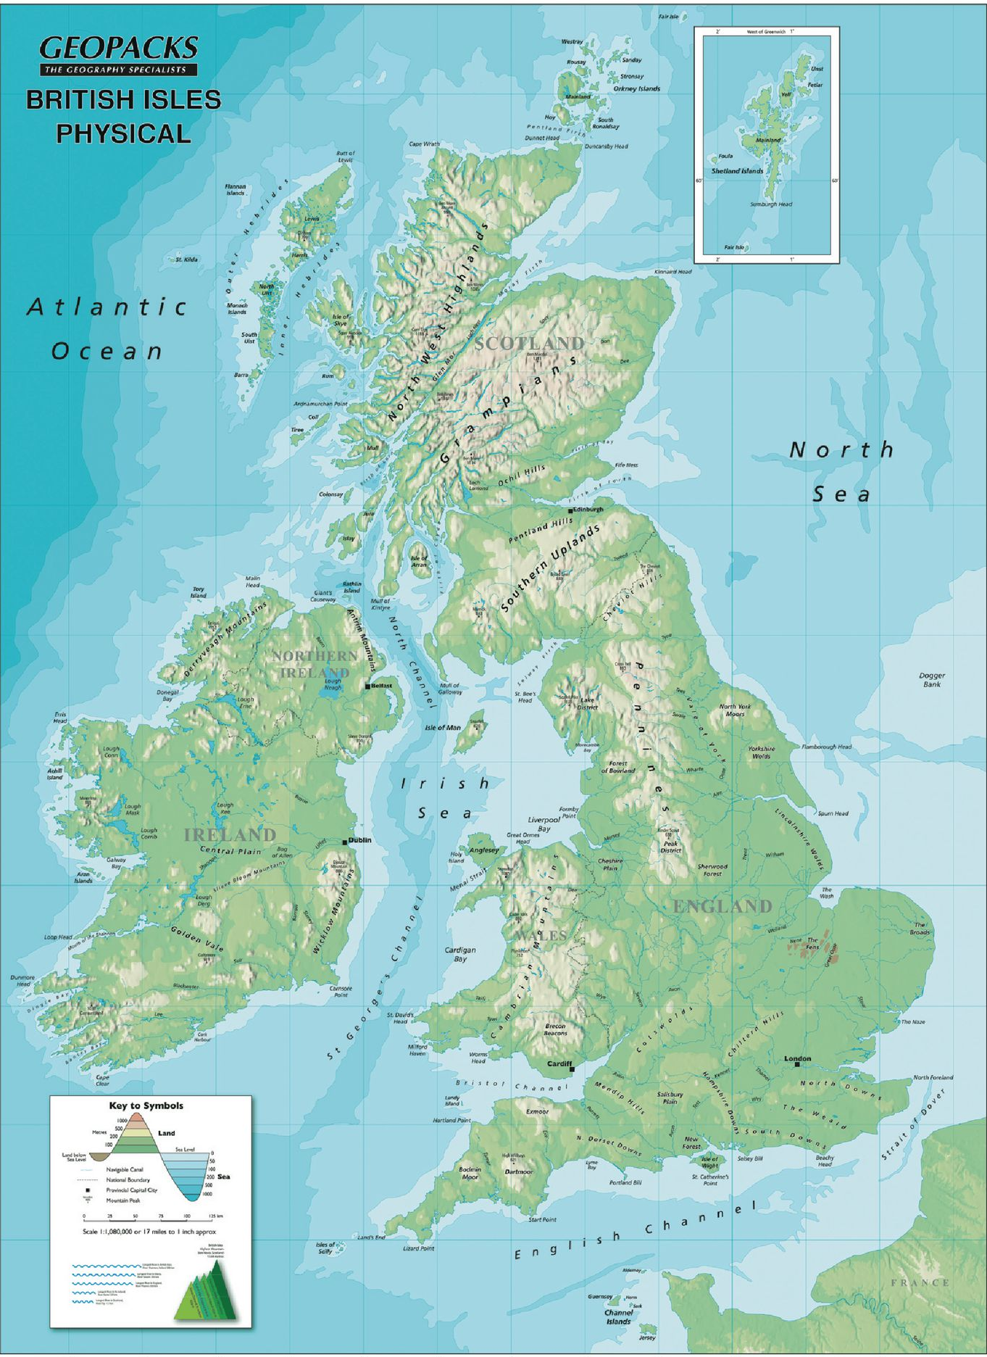
B) The British Isles = geographical term for the group of islands in Western Europe:
Ireland
Great Britain
the islands of Wight and Anglesey
the Isle of Man
the Hebrides
the Orkney Islands
the Shetland Islands
the Channel Islands
the Scilly Islands

Slide 17
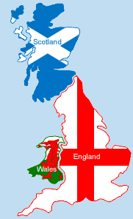
C) Great Britain is both a geographical and political designation.
Largest island in the British Isles
Separated from the mainland of western Europe by the English Channel and the North Sea.
Separated from Ireland by the Irish Sea, the North Channel and St George’s Channel.
Separation: 6, 000 BC
Great Britain = England + Scotland + Wales.

Slide 18

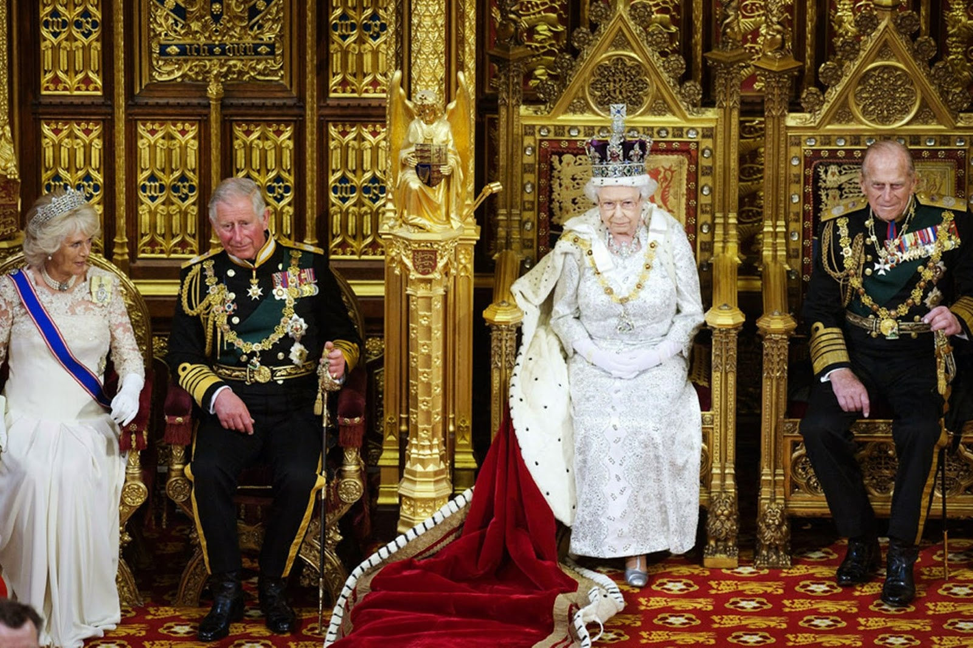
D) England
Largest division of Great Britain
Kingdom since the 9th century.
1649-1660: The Commonwealth of England.

Slide 19
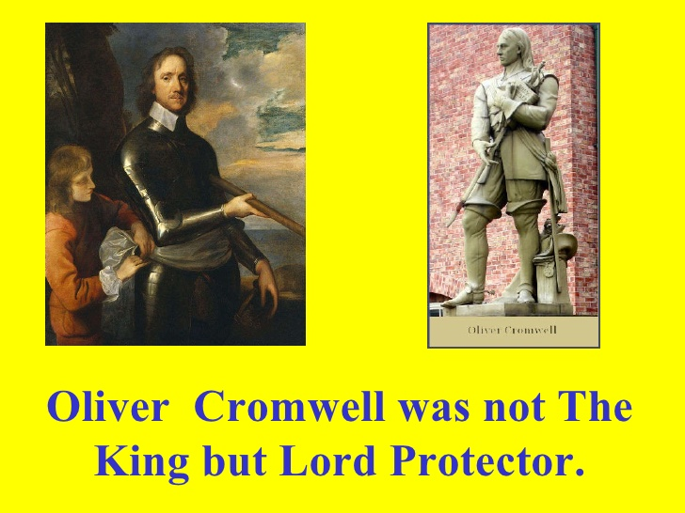

Slide 20
D) England
Largest division of Great Britain
Kingdom since the 9th century.
1649-1660: The Commonwealth of England.

Slide 21


E) Scotland
North of Great Britain.
1603 : Union of the Crowns
1707: Union of parliaments
F) Wales
West of Great Britain.
Principality
1277 & 1283: conquest by English king Edward I
1536: Parliamentary union

Slide 22
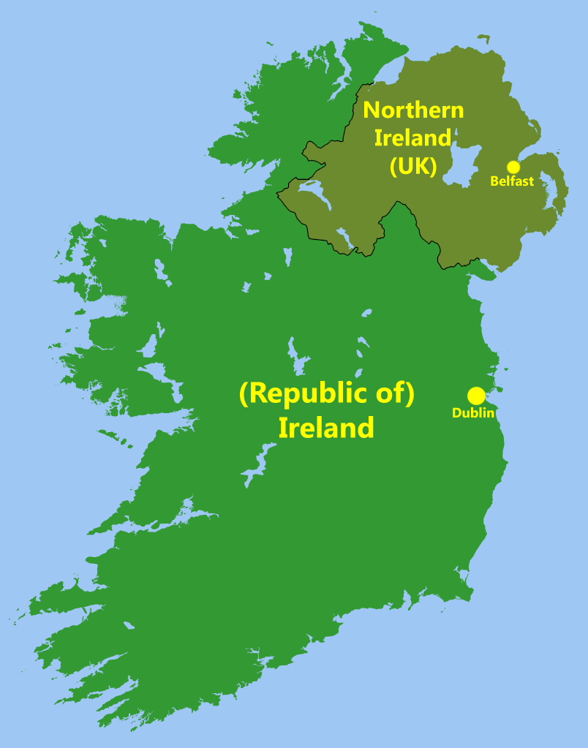

G) Ireland
Geographical term VS political entity?
16th and early 17th centuries: conquest
Dependency + colonization
1801: Union with Great Britain
19th century: unionists vs nationalists
1916: Easter Rising
1921: Division between
Irish Free State (today called the Republic of Ireland)
Northern Ireland

Slide 23
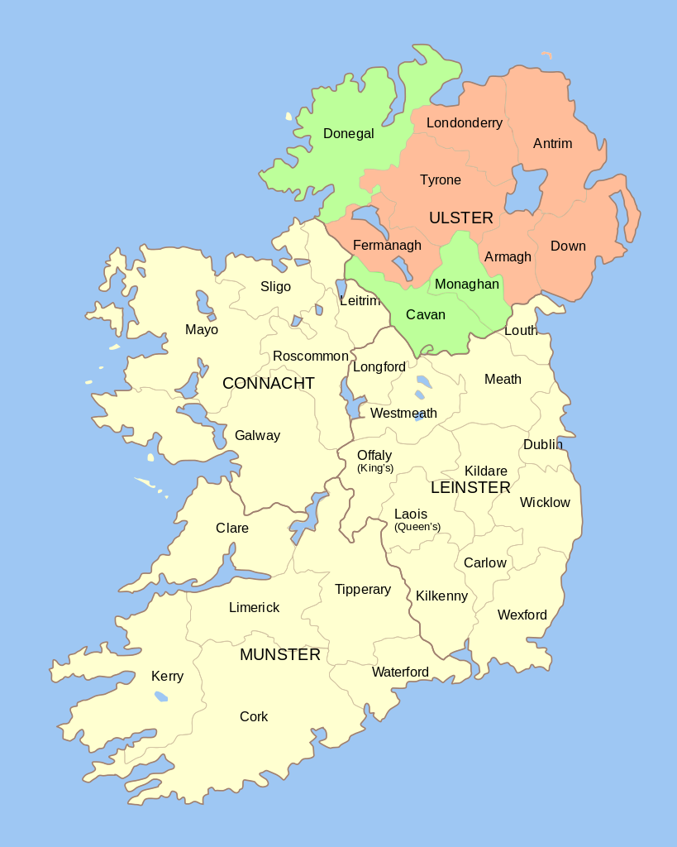
H) Northern Ireland
North eastern part of Ireland.
Nickname: Ulster.
1461: Ulster passed to the English crown.
1921: partitioned into the six counties of Northern Ireland and the Ulster province of the Republic of Ireland.

